Slide 1
JUnit 5 Spring
Notes:
封面标题特殊字体为百度简综艺.可以自行下载使用或改为微软雅黑.

Slide 2
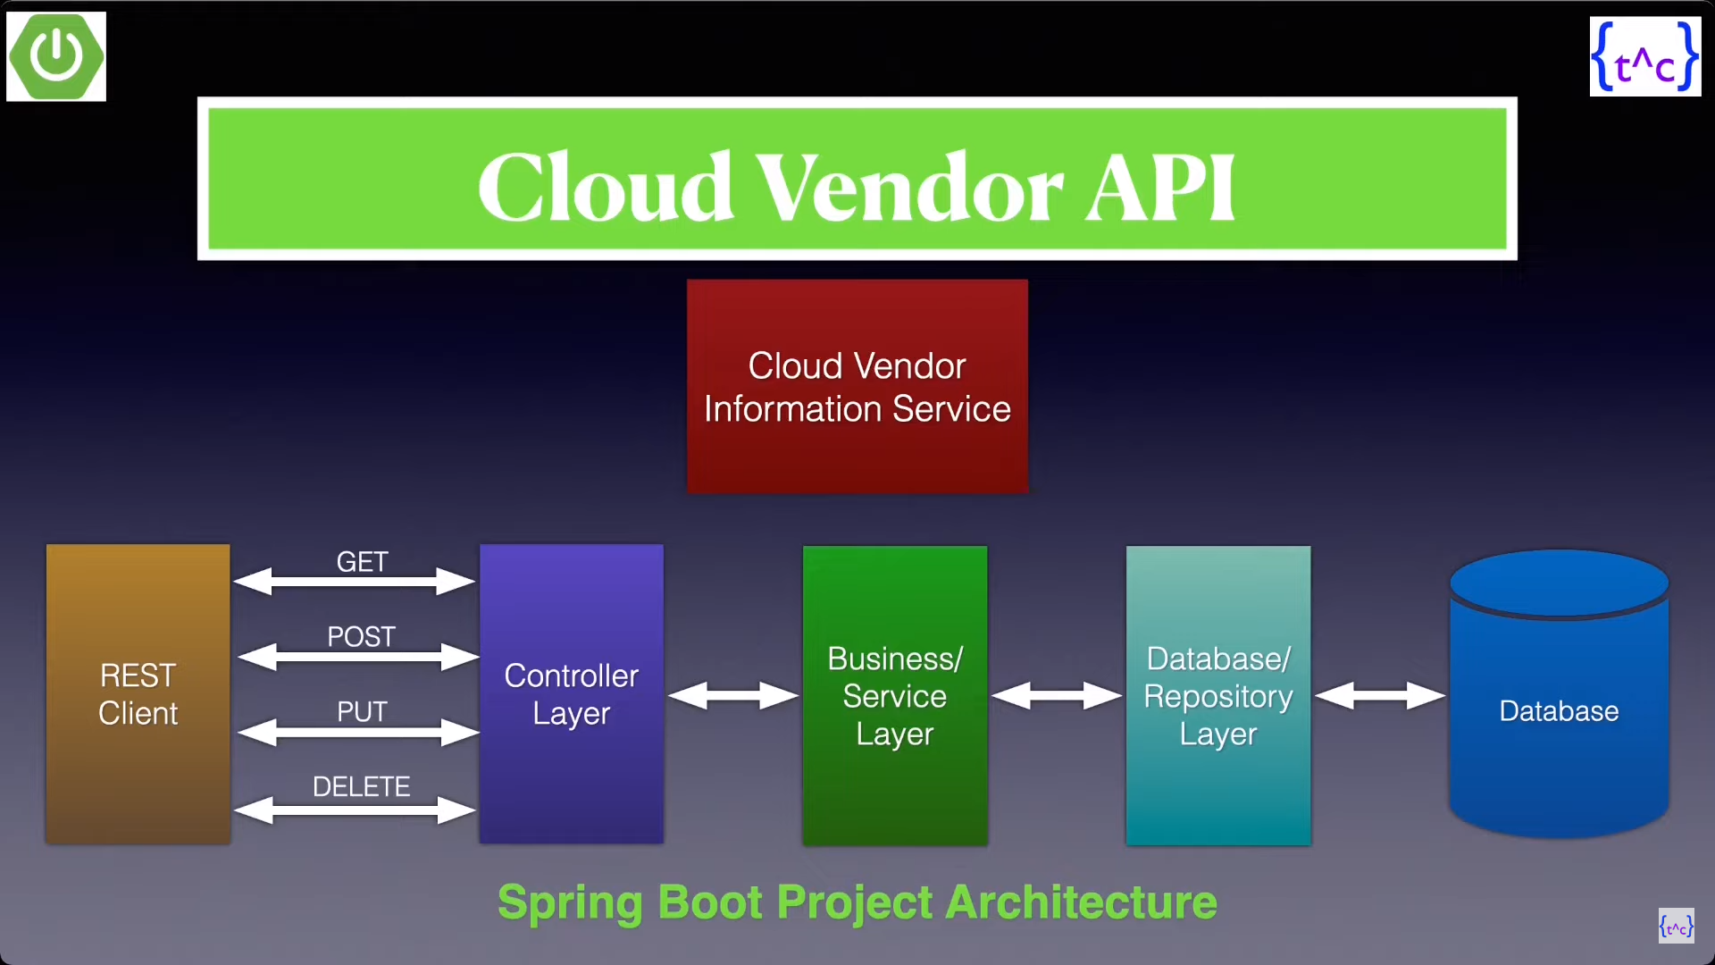

Slide 3
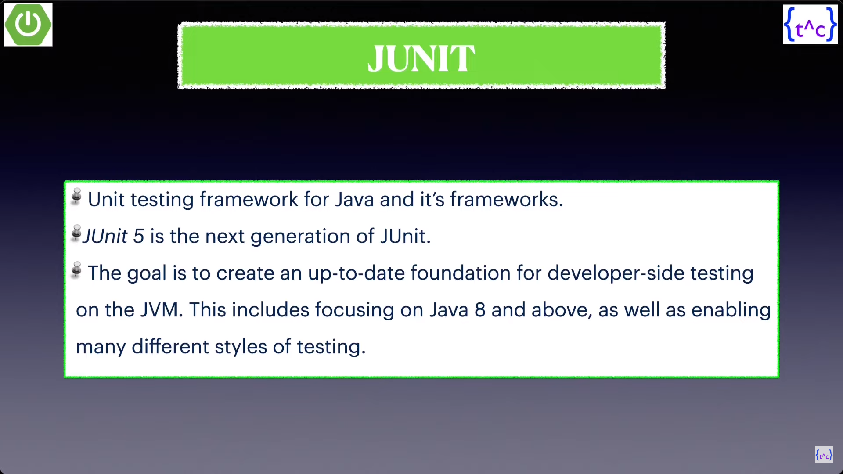

Slide 4
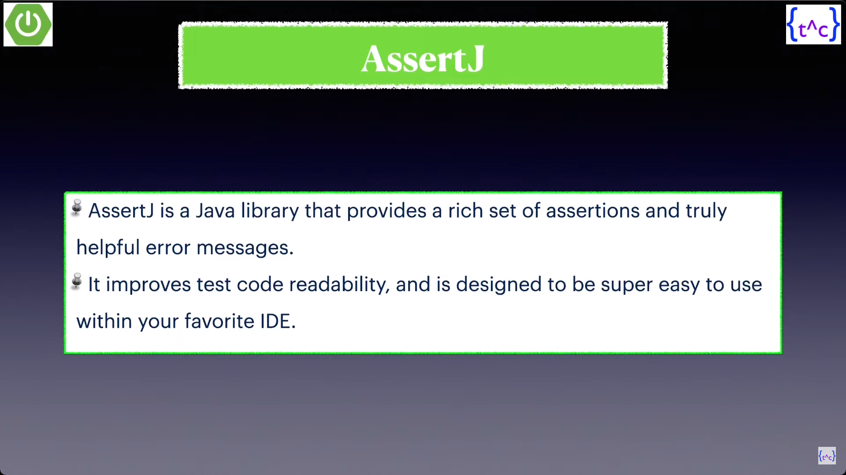

Slide 5
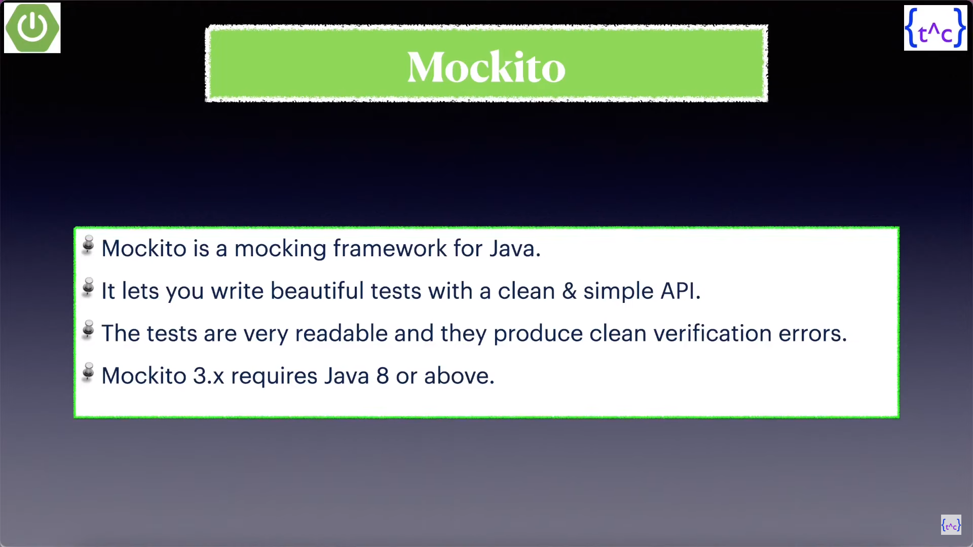

Slide 6
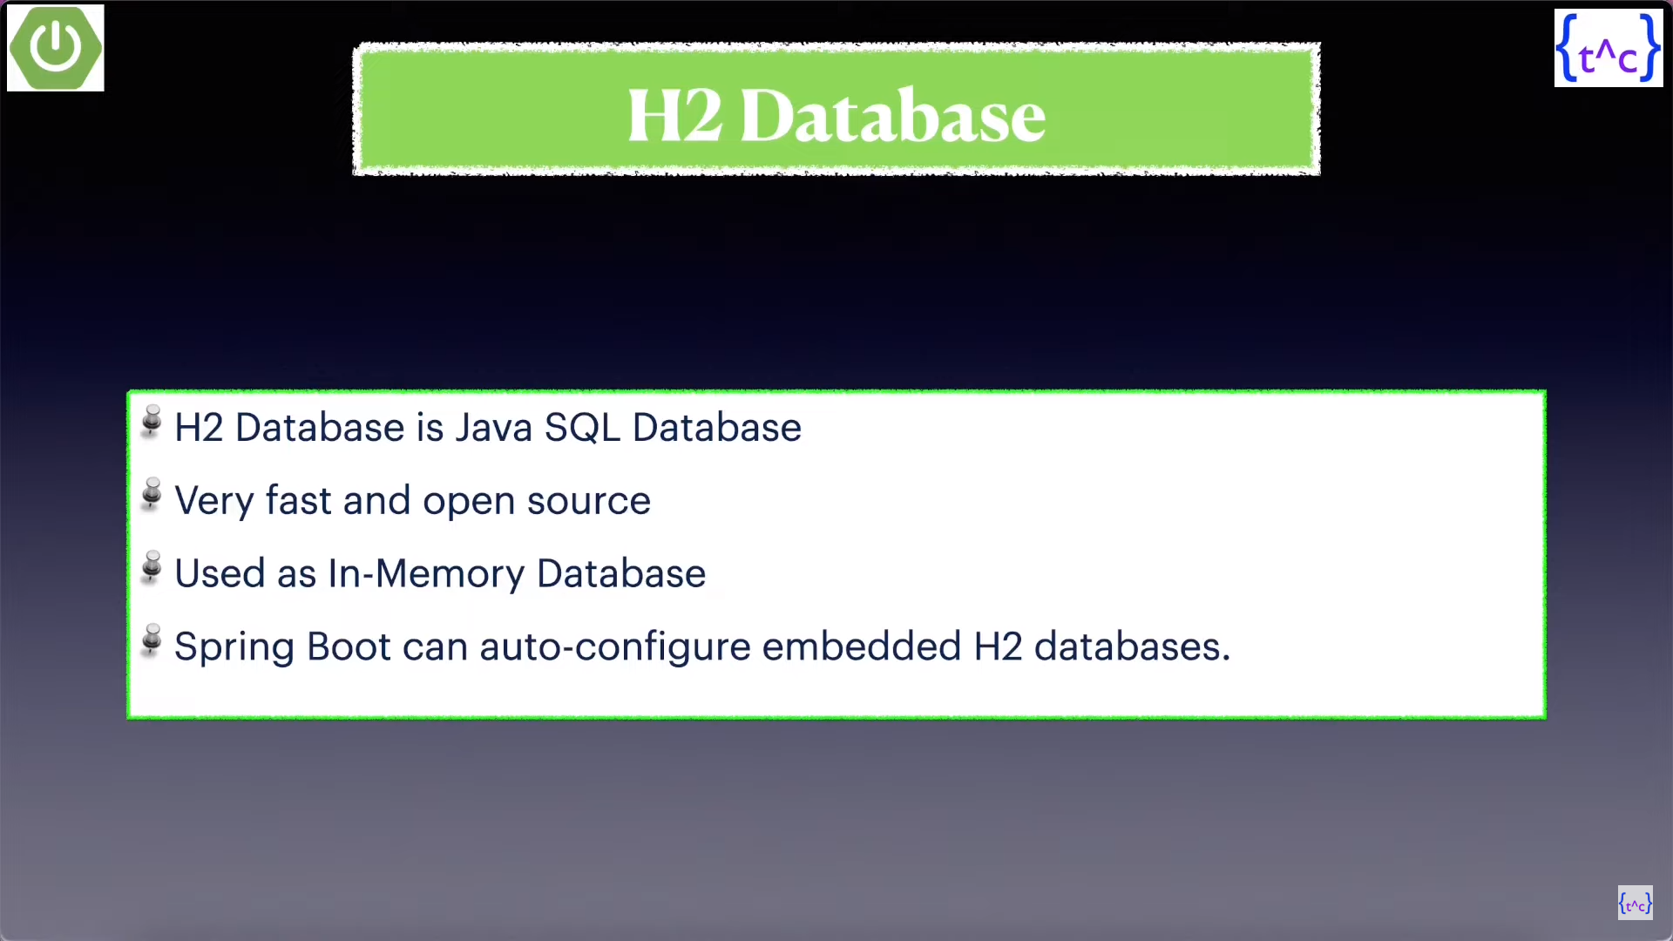

Slide 7
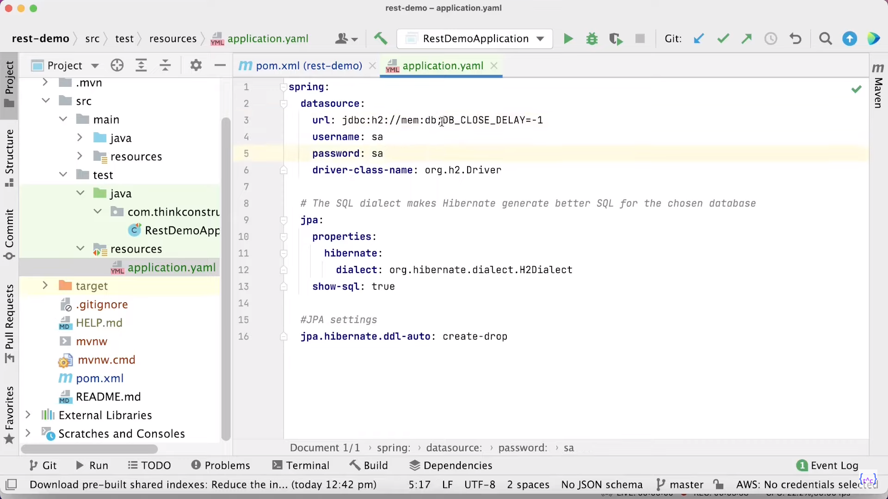
Application.yml
(H2 DB Configuration for testing)

Slide 8
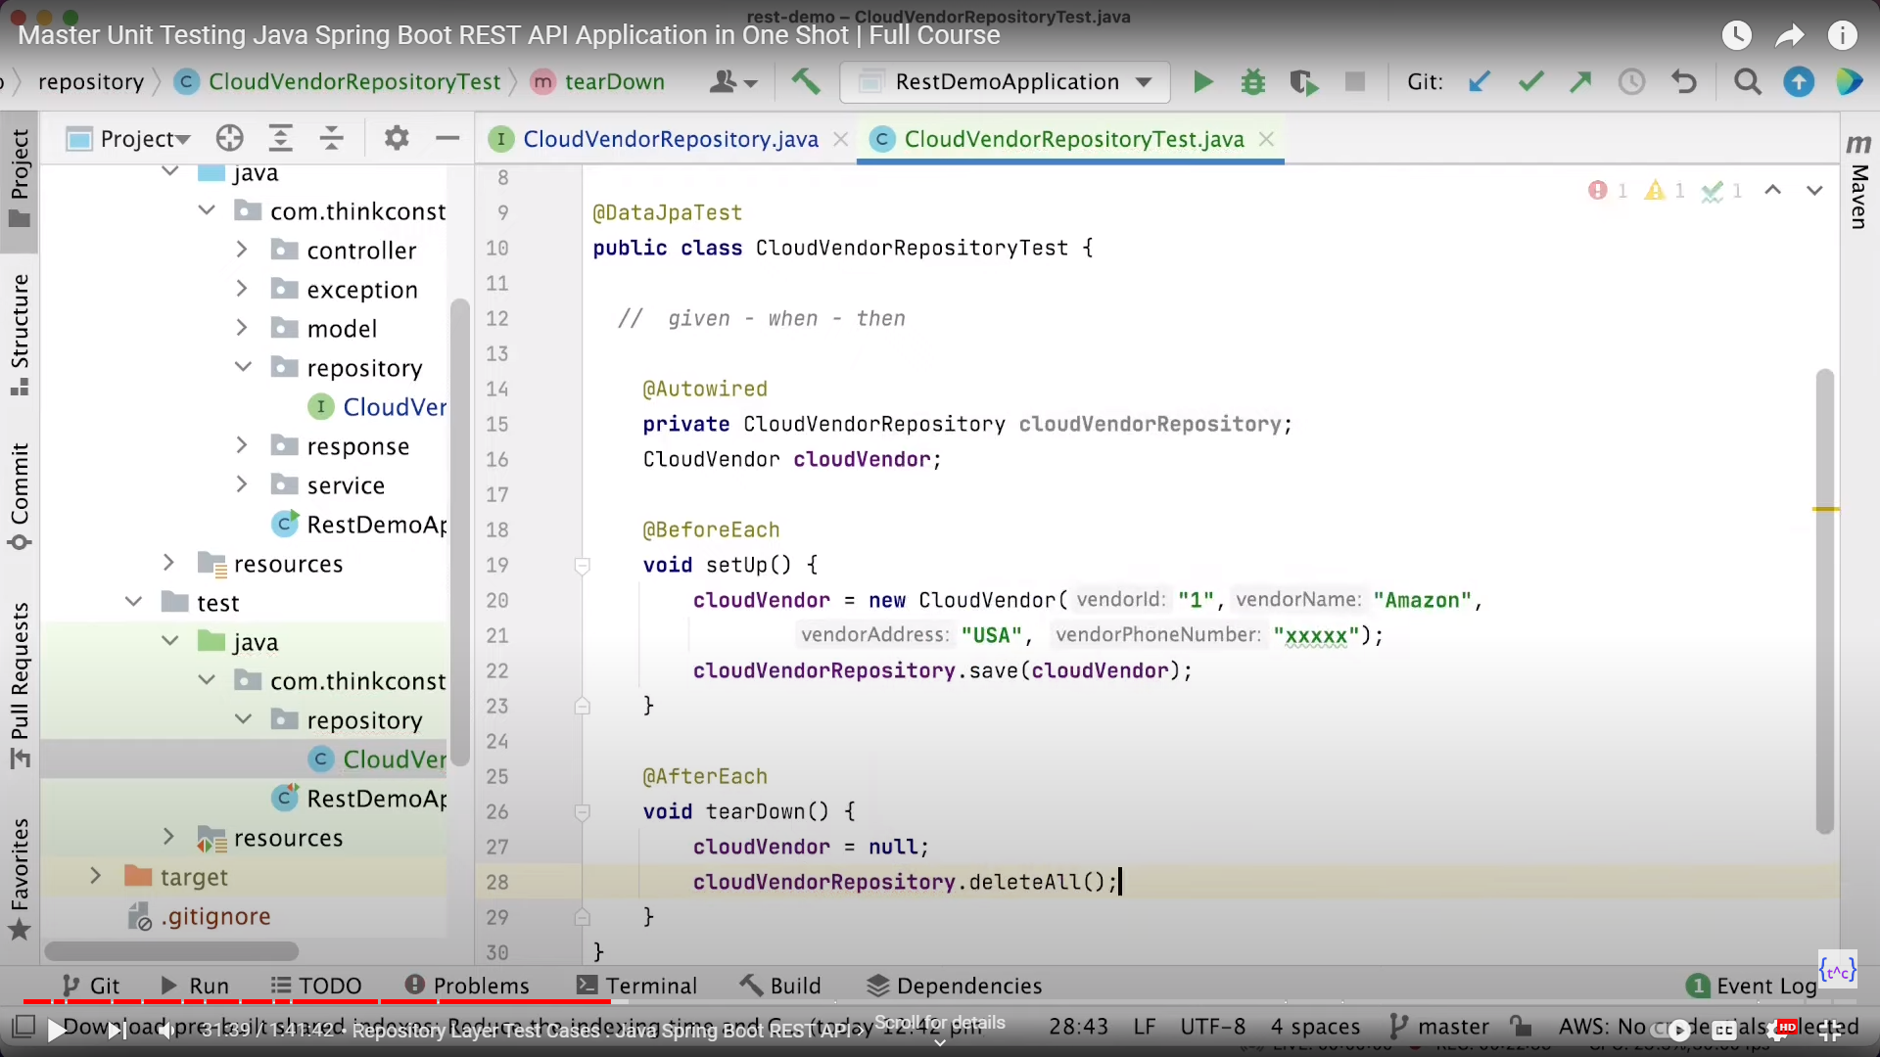

Slide 9
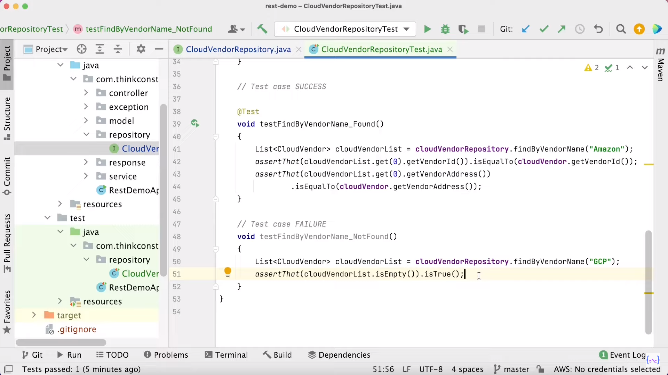

Slide 10
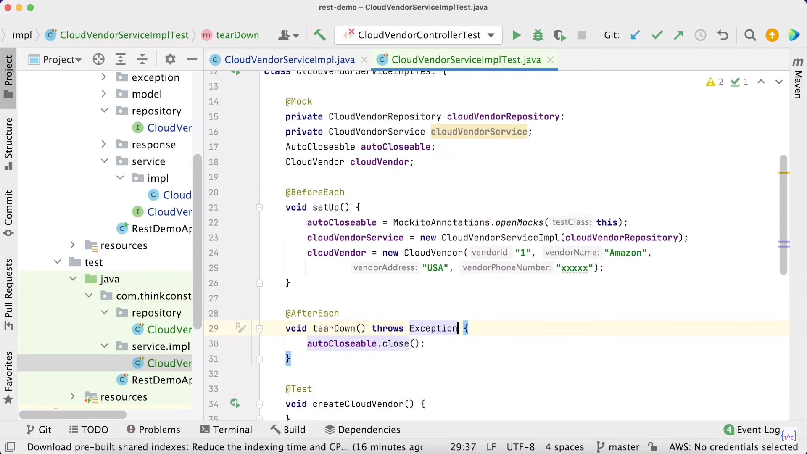
Service Testing

Slide 11
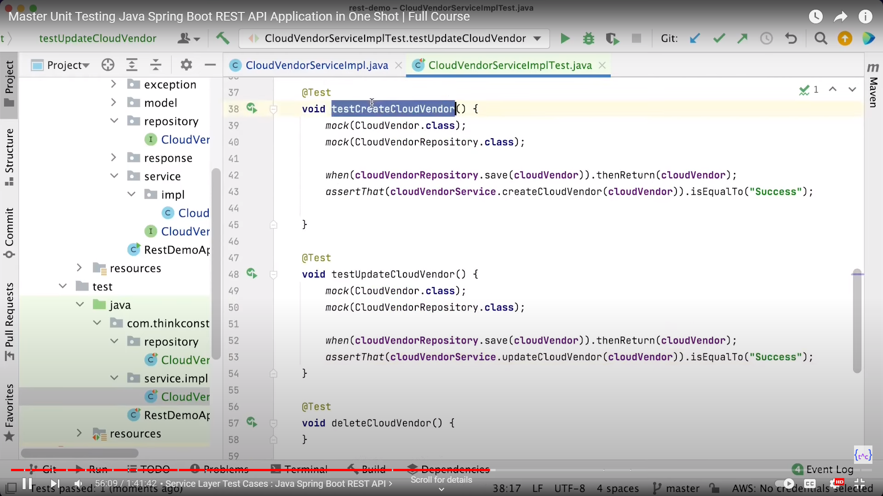
Create And Update Method Testing

Slide 12
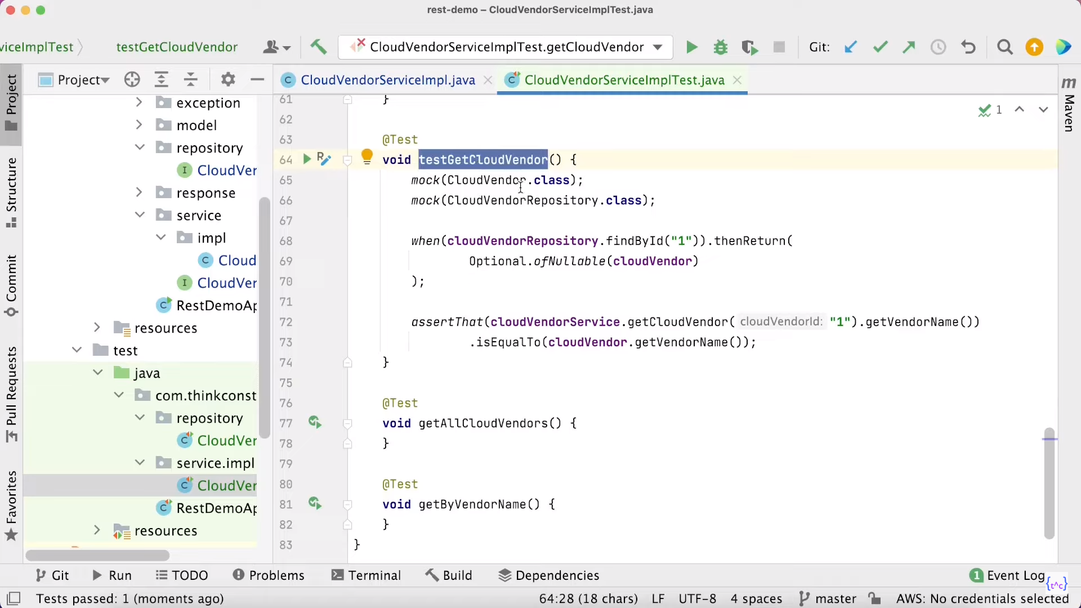
Get Method Testing

Slide 13
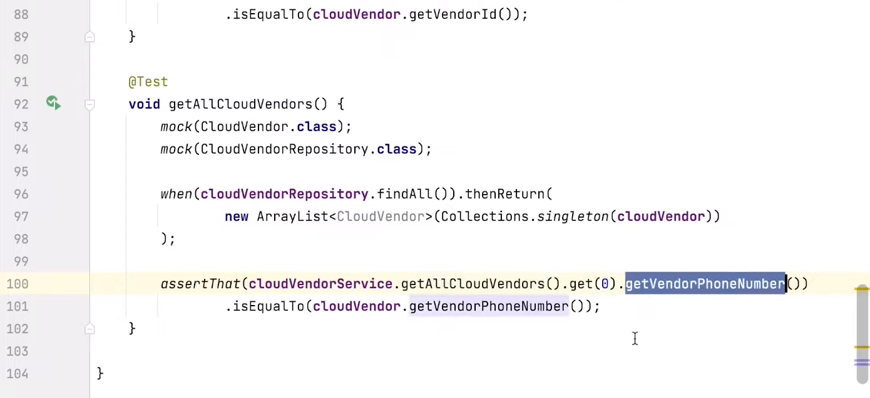
Get All Method Testing

Slide 14
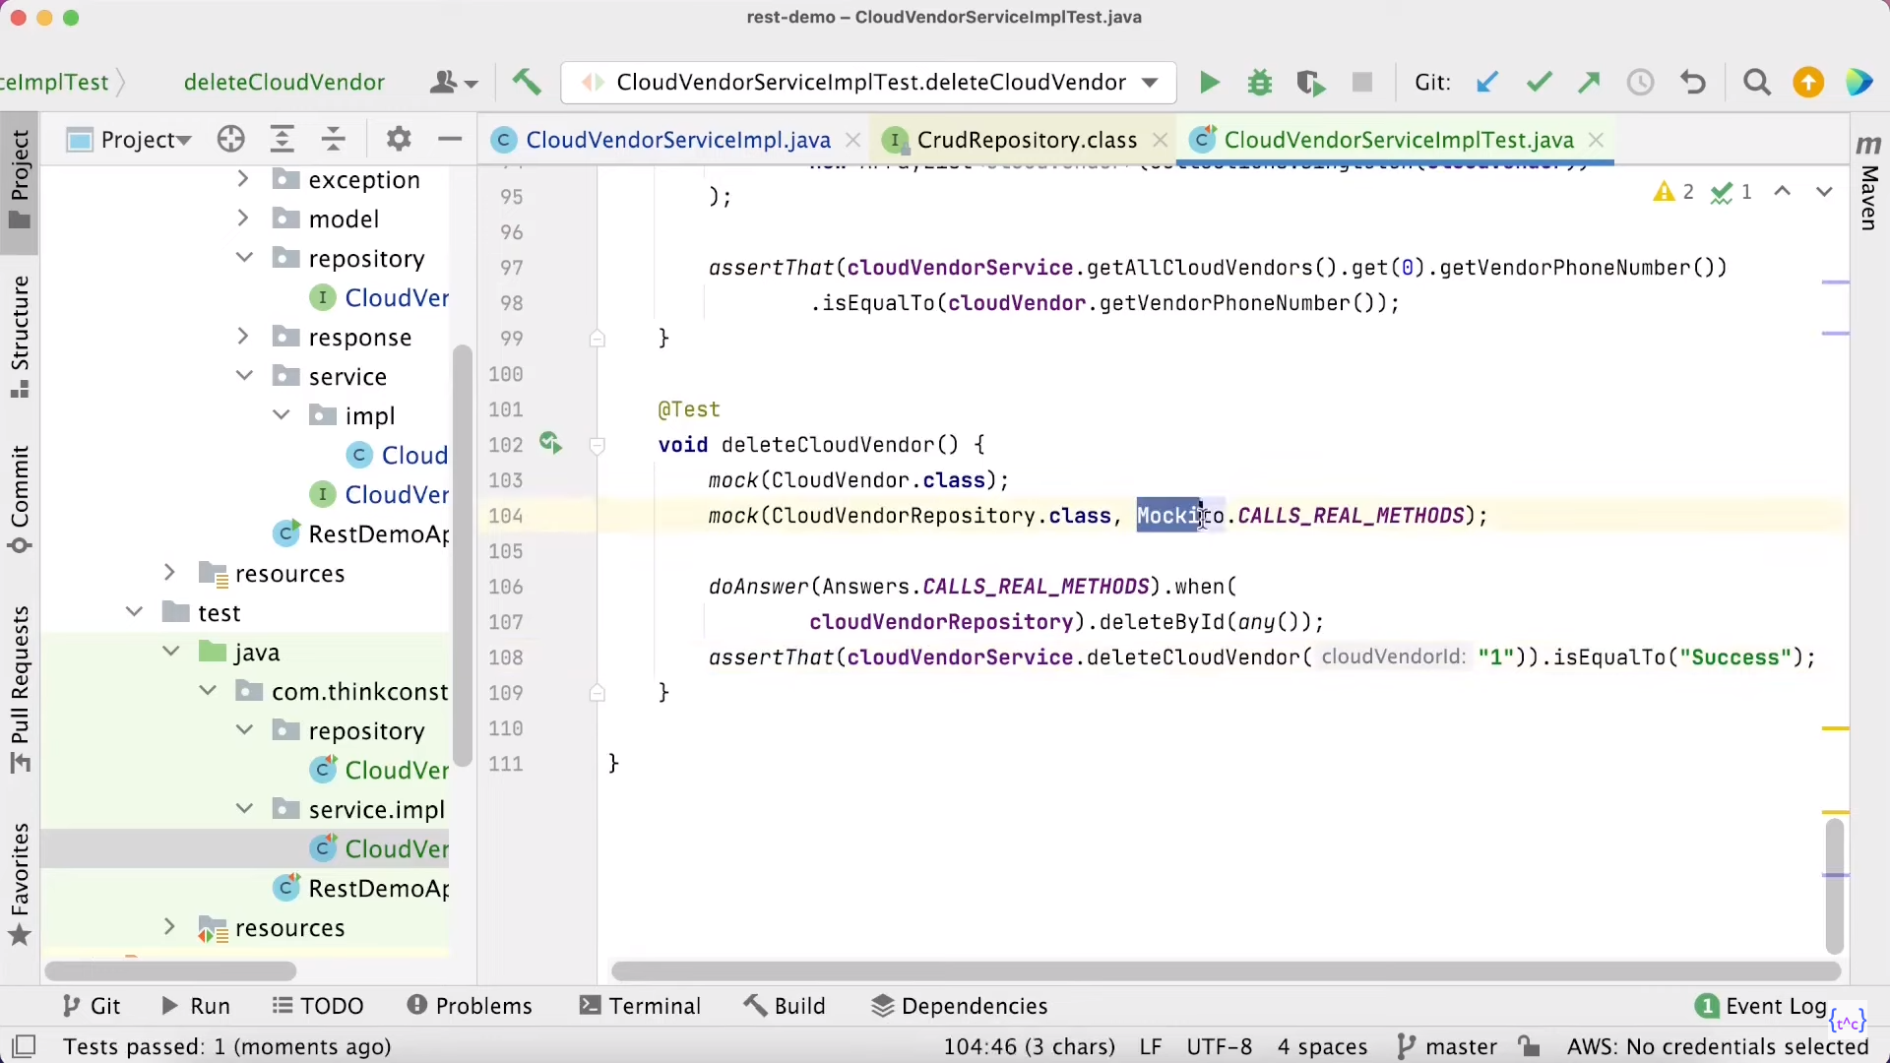
Delete Method Testing

